Slide 1
Coaxial-type resonant power transformer
Inventors: Seunghun Baek, S. Bhattacharya
Date: Dec. 13. 2011

Slide 2
Technology Overview
Overview:
Downsizing and weight reduction are main obstacles of diffusion of promising power conversion applications, such as Electric Vehicles (EV), Solid-State Transformer (SST) etc.
High frequency operation is necessary in power conversion for high power density and downsizing of power convertor applications.
The effect of parasitic components becomes significant and unpredictable in conventional fashion as the operating frequency increases. More accurate tuning and low parasitic effects are desirable.

Slide 3
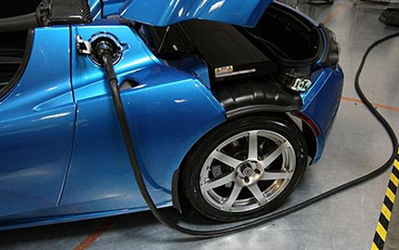
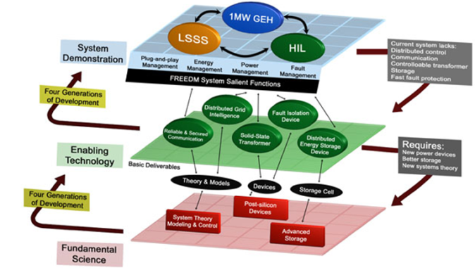
Technology Overview
Overview , Con’t:
Resonant conversion using soft-switching is one of the most popular techniques to increase operating frequency in high power capacity.
Galvanic isolation using an isolation transformer in high power equipments is necessary.
Ls
Cp
Resonant tank
HF transformer

Slide 4
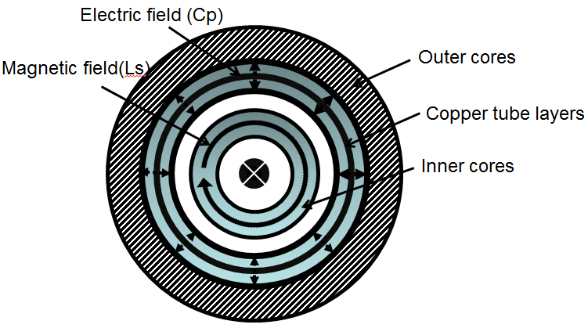
Technology Overview
The invention, the coaxial resonant power transformer (CRT), plays roles of not only an step-up or down isolation transformer but also a resonant tank, which is the heaviest and bulkiest part of power converter applications.
The CRT may incorporate the resonant tank formed by series inductance Ls and shunt capacitance Cp into its design; such integrated transformer can avoid unpredictable high frequency response and minimize the size over discrete realizations.
I
+
Cross sectional view and B and E field distribution

Slide 5
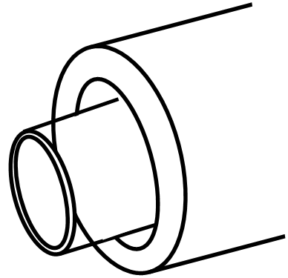
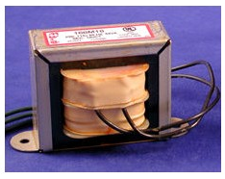
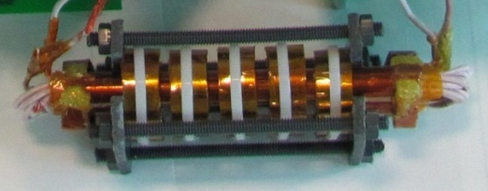
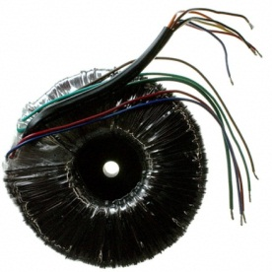
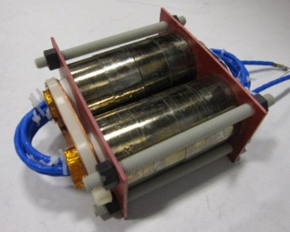
Technology Overview
Coaxial type transformer
- Very low parasitic components
- Accurately predictable high frequency response
- Ideal geometry from electrical and thermal insulation point of view
Winding
Ip
Core
Is
Ip
Core
Is
Winding
I
I

Slide 6
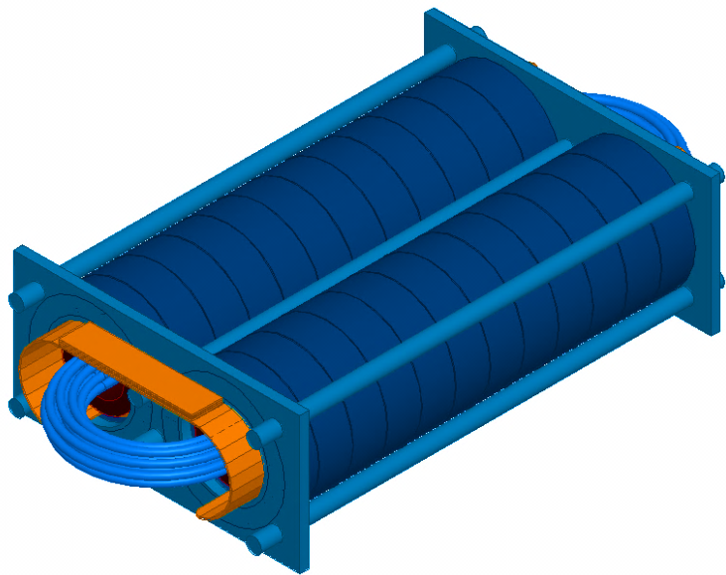
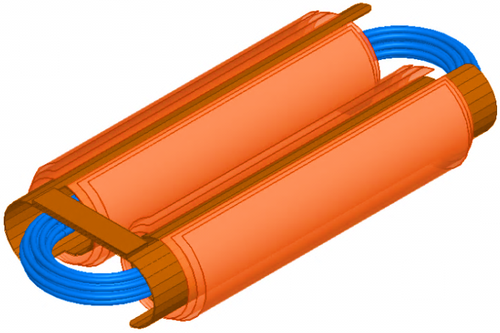
Technology Overview
Outer Cores
Outer winding
Conductor layers (Cp)
Inner Cores (Ls)
Inner winding
Equivalent circuit

Slide 7
Technology Overview: Key Features and Benefits
High Frequency Power Conversion
Simple geometry and configuration
Resonant tank integration
Predictaible and stable HF response
Excellent performance of electrical and thermal insulation
High power density
Compact size
Easy packaging

Slide 8
Potential Applications
Solid-State-Transformer, electric vehicles Etc.
Best fit for high frequency resonant converters which demand high efficiency and compact size by fine tuning of resonance.
Any power conversion application which requires galvanic isolation with high power density .

Slide 9
Problem Statement and value proposition
High frequency operation is necessary in power conversion for high power density and downsizing of power convertor applications.
The effect of parasitic components has to be mitigated and passive bulky magnetic and electric passive components
Good electrical insulation and thermal performance is desirable
Size reduction : Discrete magnetic and electric passive components can be eliminated by integration into the isolation transformer
Stable and predictable high frequency operation : Parasitic components are minimized
Congested electric stress and heat can be avoided.

Slide 10
Economic Impact
Are you able to quantify the financial impact of your invention? (Ex: Saves $X, or is X% more efficient)
  Will be more efficient and enable power conversion at high power and high frequency
  Typically 1%-3% more efficient power conversion

Slide 11
Inventorship/Ownership Issues
No inventor / ownership issue
The invention was done by Seunghun Baek and Subhashish Bhattacharya

Slide 12
Public Disclosure Issues
List any papers or public disclosures
  ECCE 2011 in Sept 2011

Slide 13
Recommended Next Actions
Asking for IPPF to be applied to your invention?
  YES
Seeking innovation champion?
  YES

