Slide 1
Novel Protection Schemes for HVDC System
Inventors: Alex Huang, aqhuang@ncsu.edu
Chang Peng, cpeng3@ncsu.edu

Slide 2
Background
DC transmission and distribution systems are more efficient when compared with traditional AC transmission system, and therefore is gaining significantly market share in today’s electric power grid.
However, protection of the fault in the DC system is harder than AC system. In AC system, the current has a zero crossing, allowing many protection devices be developed which interrupt the current at the zero crossing.
For DC system, there is no zero crossing. Moreover, since DC capacitors are used in the DC system, it stores huge amount of energy, equal to 0.5*C*VDC^2, where VDC is the DC bus voltage. For HVDC system, VDC is above 200kV. So large amount energy will be discharged when a fault happens.
This invention provide normal protection again DC system fault, and will enable even wider adoption of the DC system.

Slide 3
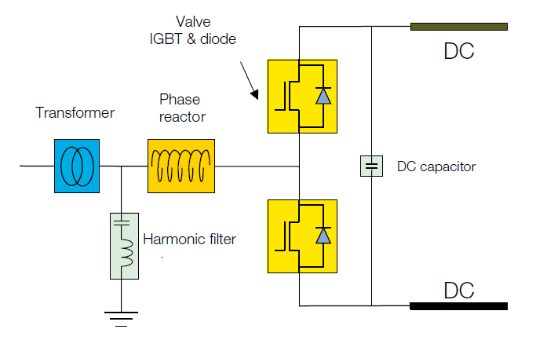
Background: Voltage Source Converter (VSC) is generally used on one side of the HVDC to change AC to DC
Simplified diagram of a VSC converter station, source: ABB

Slide 4
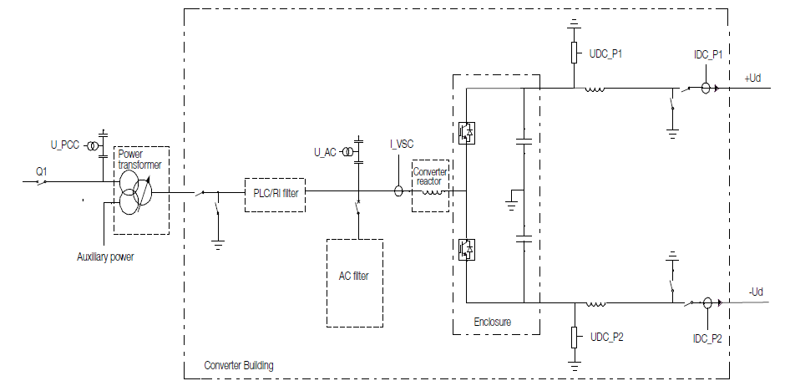
Problem: Pole to Pole fault on DC side
…the most severe fault scenario
Most severe fault scenario: the fault happen very close to on dc side
Single diagram of a VSC converter station, source: ABB

Slide 5
State-of-the-art protection for the Pole to Pole fault on DC side
…present handling method
Step 1: Block the IGBTs, in several ms after detection of faults
Effect: protect IGBT devices
Problem: Diodes continue to feed the fault current from the AC side
Step 2: Trip AC side circuit breakers, in several 100 ms after detection
Effect: stop power flow from AC source on both sides
Problem: 1) whole VSC HVDC transmission system is down 2) The process takes
too long and the fault current is
Single diagram of a VSC converter station, source: ABB

Slide 6
Major Problem: The key role of DC capacitor
None of above measures handle this major problem during fault:
The DC Capacitor is short circuited during fault, providing large and rapid fault current rise
Major damages it might cause:
1) To cause large and fast-rising fault current
2) To DC cables: overcurrent and thus thermal severity
2) To DC capacitors: abnormal discharge, reduced lifetime
3) To cause large current flowing through diodes when capacitor is discharged

Slide 7
Invention 1: DC Capacitor Circuit Breaker
…quickly limit the fault current in the DC cap branch
Add a DC circuit breaker her
Ultra fast interruption of the DC cap current to limit capacitor discharge.
The circuit breaker can be implemented by
  A solid state semiconductor switch, interrupt in us;
  A fast mechanic switches, interrupt in 100 us.

Slide 8
Proof-concept simulation: DC Capacitor Circuit Breaker
…limit the fault current in time
55kA Capacitor & fault current
18kA Diode current
24kA Capacitor & fault current
8.5kA Diode current
Fault happens at 1.0 s;
IGBTs block after 2 ms;
AC CBs trip after 100 ms.
Very high fault current of 55 kA
Fault happens at 1.0 s;
DC capacitor CB trip after 500 us;
IGBTs block after 2 ms;
AC CBs trip after 100 ms.
Fault current reduced to 24 kA

Slide 9
Increase the DC breaker speed to 50us
Capacitor & Fault:55kA
Fault:10kA
Diode: 18kA
Cap:2.8kA
Diode:8.5kA
AC current
AC current
Fault happens at 1.0 s;
AC CBs trip after 100 ms.
Fault happens at 1.0 s;
DC capacitor CB trip after 50 us;
AC CBs trip after 100 ms.
Fault current reduced to 10kA

Slide 10
DC Capacitor Circuit Breaker
…limit the fault current in time
Benefit:
No major losses during normal operation
Capacitor overcurrent rating dramatically reduced;
Capacitor lifetime extended;
Cables overcurrent severity alleviated

Slide 11
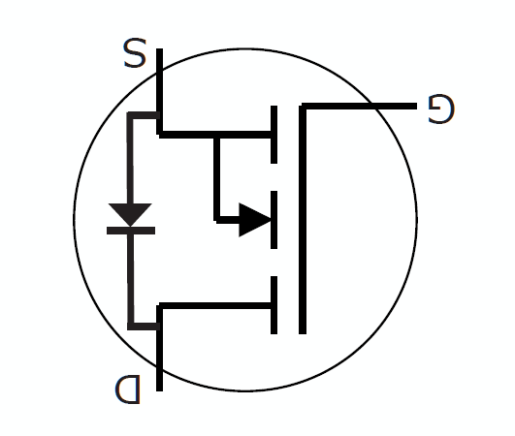
Preferred Embodiment of the Breaker using a semiconductor switch like MOSFET and a diode
MOSFET is normally on
During fault, turns off the MOSFET

Slide 12
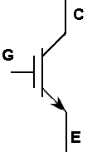
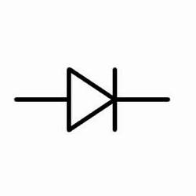
Preferred Embodiment of the Breaker using a semiconductor switch like IGBT and a diode
IGBT is normally on
During fault, turns off the IGBT

Slide 13
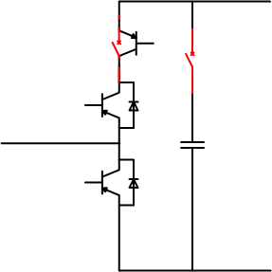
Invention 2: Add An additional switch/breaker to the VSC
Additional switch/breaker
There are several embodiments of this invention and will be included when we file a patent
The additional switching will cut off the AC side fault current when there is a DC side fault , leaving the DC capacitor the only source of the fault current, which will be protected by our Invention 1

Slide 14
DC Capacitor Circuit Breaker
…limit the fault current in time
Capacitor & Fault:55kA
Fault:10kA
Diode: 18kA
Cap:2.8kA
Diode:8.5kA
Cap & Fault:2.8kA
Diode: 1.2kA
AC current
AC current
AC current
Fault happens at 1.0 s;
AC CBs trip after 100 ms.
Fault happens at 1.0 s;
Capacitor CB trip after 50 us;
AC CBs trip after 100 ms.
Fault happens at 1.0 s;
Capacitor CB trip after 50 us;
Converter blocks at 50 us;
AC CBs trip after 100 ms.
Fault current reduced to 2.8 kA

Slide 15
Invention 3: Use a different AC/DC converter topology that will cut of the AC side current
When there is a DC side fault.
The performance of the protection will be similar to Invention 2.
New AC to DC converter with current shut off capability
AC grid
There are several embodiments of this invention and will be included when we file a patent

